Slide 1


MALNAD COLLEGE OF ENGINEERING Under the auspices of M.T.E.S
(An Autonomous Institution Affiliated to VTU, Belagavi)
P.B No. 21, Hassan-573202, Karnataka
Department of Information Science and Engineering
Malnad College of Engineering
Hassan-573201
2022-23
Mini Project-1(21IS507)
AUTOMATED ROOM ALLOCATION SYSTEM
PRESENTED BY: SUGNYAN K 4MC21IS106
SUHAS KP 4MC21IS107
PAVAN B 4MC21IS077
S.M.YATHIN 4MC21IS090
UNDER THE GUIDANCE OF
DR. ANANDA BABU J
B.E., M Tech., PhD.,

Slide 2
Contents
INTRODUCTION
PROBLEM STATEMENT
SYSTEM ANALYSIS
1. EXISTING SYSTEM AND THEIR DRAWBACKS
2.PROPOSED SYSTEM
4. REQUIREMENT SPECIFICATION
1.FUNCTIONAL REQUIREMENTS
2.NON-FUNCTIONAL REQUIREMENTS
5. SYSTEM DESIGN
6. CONCLUSION

Slide 3
INTRODUCTION
In our college, we get a pdf containing the seat allotment of tests and exams.
This method is ineffective since it needs someone to look after the process of distributing students for every monthly tests and exams.
Examination seat allotment system is a software project that solves this problem.
This unique implementation in our college will not only help to reduce the work of staff but also it will increase the accuracy of distribution.
In this project we are covering so many edge cases where every student will have different seating allotment for different exams with changing room availability without increasing the human efforts.

Slide 4
PROBLEM STATEMENT
The problem statement is to develop a user friendly software to distribute the large number of students in different exam rooms that can be used multiple times to reorder the arrangement in case of different constraints.

Slide 5
EXISTING SOLUTION
For the seat allotment in our college. The staff of the examination section need to manually distribute the students to their exam halls. This process need to repeated for every exam since different exam halls and rooms are available in different days.
Drawbacks:
Time-Consuming Manual processes are slow.
Error-Prone Prone to human mistakes.
Data Redundancy Multiple entries for similar data.
Tracking Difficulty Challenges in change tracking.
Allocation Delays Dependent on faculty timing.

Slide 6
Functional Requirements:
User Authentication: Enable login for authorized faculty members.
Input Interface: Provide a user-friendly interface for faculty to input student registration numbers and course codes.
Database Connectivity: Establish connectivity with the college's MySQL database to fetch student, course, and room data.The files are kept in cabinets in different sections which makes it difficult to locate when mixed up.
Seat Allocation Algorithm :Implement logic to allocate seats based on available rooms, course sizes, and room capacities.
Real-time Updates :Ensure instant updates on room availability based on the current database information.
File Generation: To generate PDF or CSV documents detailing seat allocations for faculty review.

Slide 7
SOFTWARE REQUIREMENTS
Programming Language: Java for application development.
Database Management System: MySQL for data storage and retrieval.
Libraries: iText for PDF/Excel generation. JDBC for database connectivity.
Hardware Requirements: Computing Resources
Minimum: Standard desktop/laptop configuration with Java development environment.
Recommended: Higher processing power for faster data processing.
Network Connectivity: Stable internet connectivity to access the college's MySQL database.
Storage: Adequate storage space to store the application and generated files.

Slide 8
Proposed Solution:
Java and MySQL Application for Seat Allocation
Automation: Eliminates manual desk counting and document creation.
Database Integration: Centralizes data, preventing inconsistencies.
User-Friendly Interface: Faculty inputs student and course details conveniently.
Real-time Updates: Provides immediate room availability.
Overcoming Old Problems
Error Reduction: Minimizes human errors for accurate data.
Centralization: Mitigates redundancies and inconsistencies.
Efficiency: Saves time compared to previous manual methods.
Standardization: Ensures consistent allocation practices. This solution significantly improves accuracy, efficiency, and standardization, addressing previous drawbacks of the manual seat allocation system.

Slide 9
PYTHON CODE SOLUTION
Here we are manually entering all the details that are required for the generation of the PDF.
The details include several available rooms, the number of students, number of seats in each room.
After collecting all the data with the help of some loops we can iterate over the USN of each student and allocate the seats for them.
After allocation with the help of Python libraries we can generate a pdf and share the pdf with students.
SOFTWARE REQUIREMENTS
Python code execution environment we are using Pycharm.
We need report lab and OS libraries for PDF generation.

Slide 10
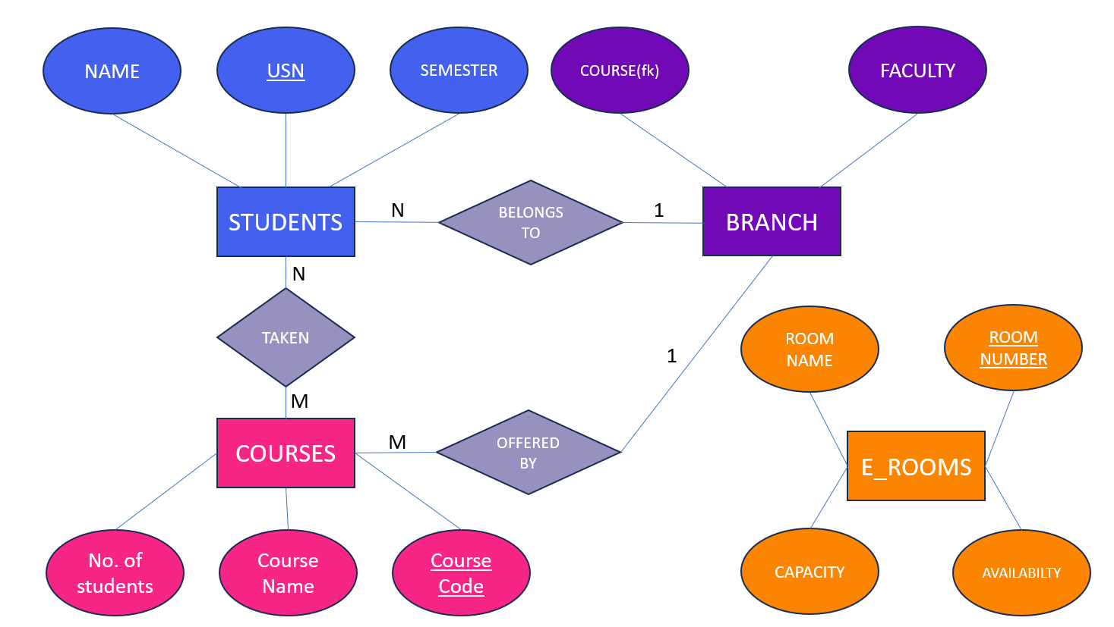
ER DIAGRAM

Slide 11
SCHEMA DIAGRAM:
STUDENT
NAME |  | USN | SEMISTER | BRANCH
COURSE
COURSE CODE | COURSE NAME | Department
BRANCH
HOD | FACULTIES | COURSES(FK) | BRANCH NAME | B_ID
EXAM HALLS/ROOMS
ROOM NO | ROOM NAME | CAPACITY | Department

Slide 12
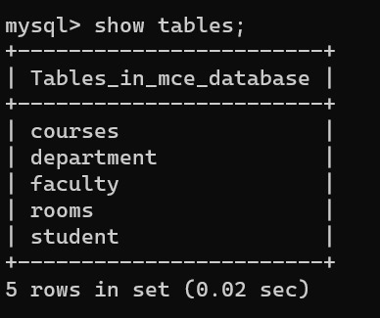
MySQL database Tables

Slide 13
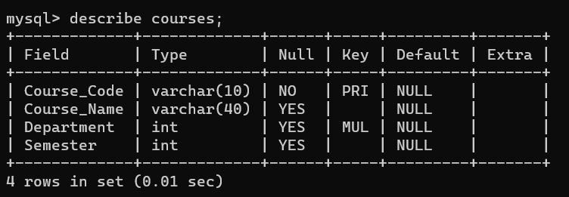
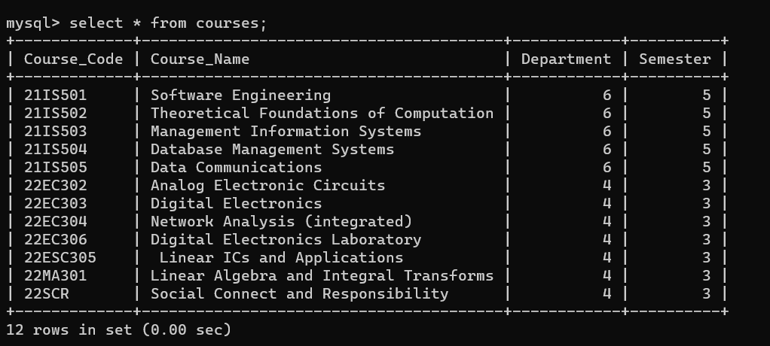

Slide 14
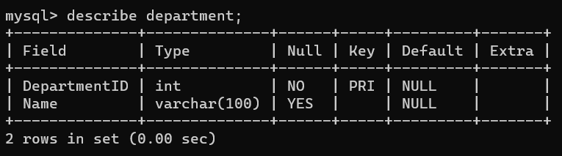
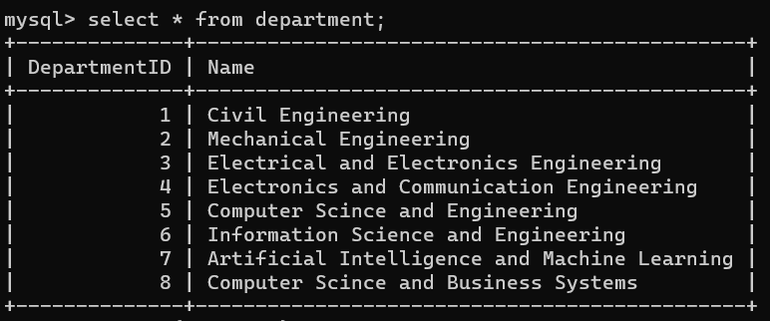

Slide 15
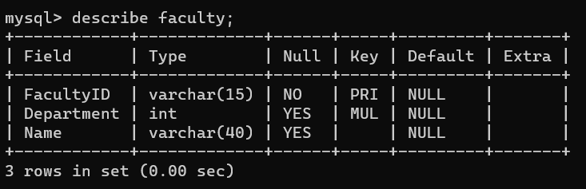
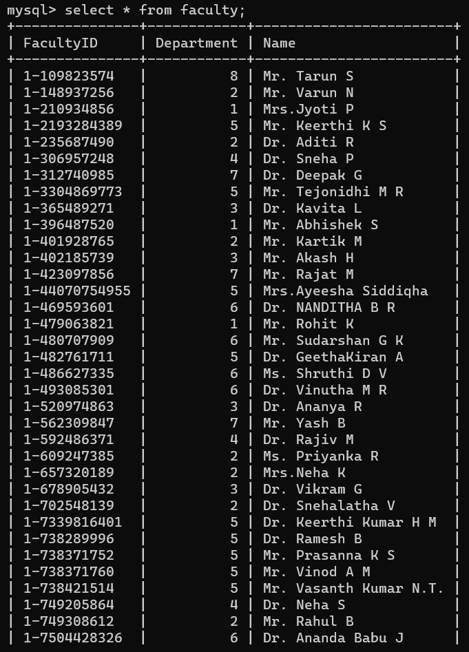
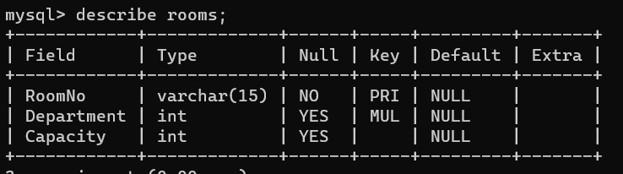
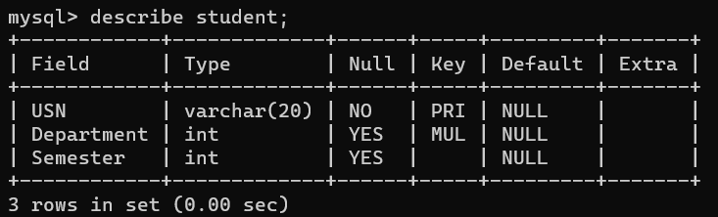

Slide 16
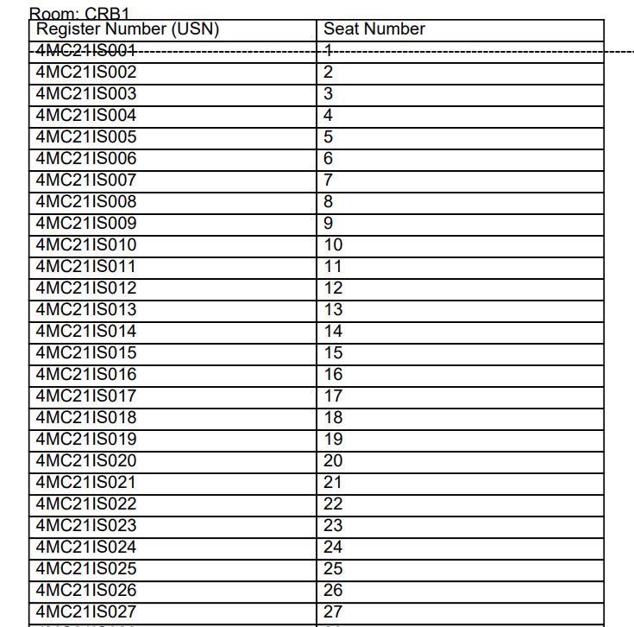
Output A PDF is generated in the designated folder with seating information.

Slide 17
CONCLUSION
The project presents an innovative solution leveraging Java and MySQL to automate seat allocation, streamlining a previously manual process. By centralizing data, offering real-time updates, and providing a user-friendly interface, it enhances accuracy and efficiency. This solution mitigates errors, improves standardization, and ensures swift, secure allocation practices. Overall, the project marks a significant advancement in optimizing room allocation procedures, promising increased efficiency and reliability in academic space management.

Slide 18
THANK YOU

